Slide 1
ONLINE HEADSET STORE
By
Nandha SK

Slide 2


Agenda
A
Introduction
Existing Solution
Proposed Solution
Software Requirements
Frontend and Backend
Modules and Screenshots

Slide 3
Introduction
In response to the increasing demand for quality headphones in today’s digital landscape, our headphone online shop aims to provide aconvenient and enjoyable shopping experience for customers· Our platform will offer a diverse selection of headphones, including wireless, noise-cancelling, gaming, and studio-grade models.. Customers can easily browse through different brands and types, read detailed descriptions, view product images, and make secure purchases· We are committed to delivering a user-friendly interface, reliable payment options, and responsive customer support to ensure a shopping journey for headphone enthusiasts and everyday consumers a like

Slide 4
Existing Solution
Customers can create accounts, explore a variety of headphone options by brand and specifications, add items to their cart, and securely complete their purchases through integrated payment options
They can also leave reviews for products they've purchased. Administrators have access to a dashboard to manage products, orders and customer accounts, ensuring smooth operations.
The system likely employs modern technologies for both frontend database system for storing product and user data.
Continuous updates and enhancements are likely performed

Slide 5
Proposed Solution
The online headphone shop system will enable users to easily browse, select, and purchase headphones and accessories from a web-based platform.Customers can create accounts, search for specific products, and view detailed descriptions and images.
They can add items to a shopping cart and securely checkout using integrated paymentoptions.Administrators will have access to a dashboard to manage products, orders, and inventory efficiently.
The system will use modern web technologies for both frontend and backend development, ensuring a responsive and user-friendly experience.Optional features like customer reviews, wisblists, and email notifications will enhance user engagement.
The project will involve planning, development, testing, and deployment to create a robust online shopping platform for headphones.

Slide 6
Software Requirements
The software required are
Web browser-Google Chrome
ReactJS, CSS, Javascript, ExpressJS
VS Code - IDE
MongoDB Atlas

Slide 7
Modules
The Modules are
Registration Page
Product Adding Page
Cart Page
Payment Page

Slide 8
Registration Page
In a Headset store , the login module plays a critical role in ensuring secure and streamlined access for users, administrators, and other stakeholders. Here’s a comprehensive description of the login module:
The login module is designed to authenticate users, administrators, and other authorized personnel, allowing them access to the system's features based on their roles. This module ensures that only registered and verified individuals can interact with the system, maintaining security and preventing unauthorized access.
The login module can be access after registered the account in the page.

Slide 9
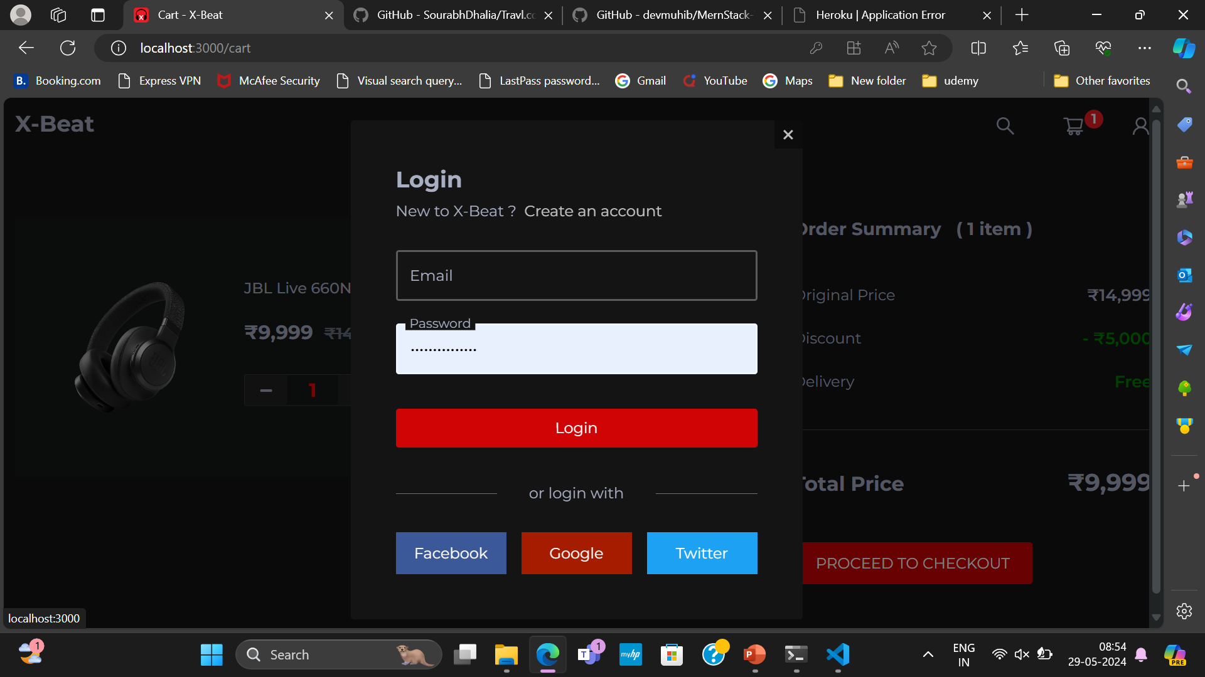
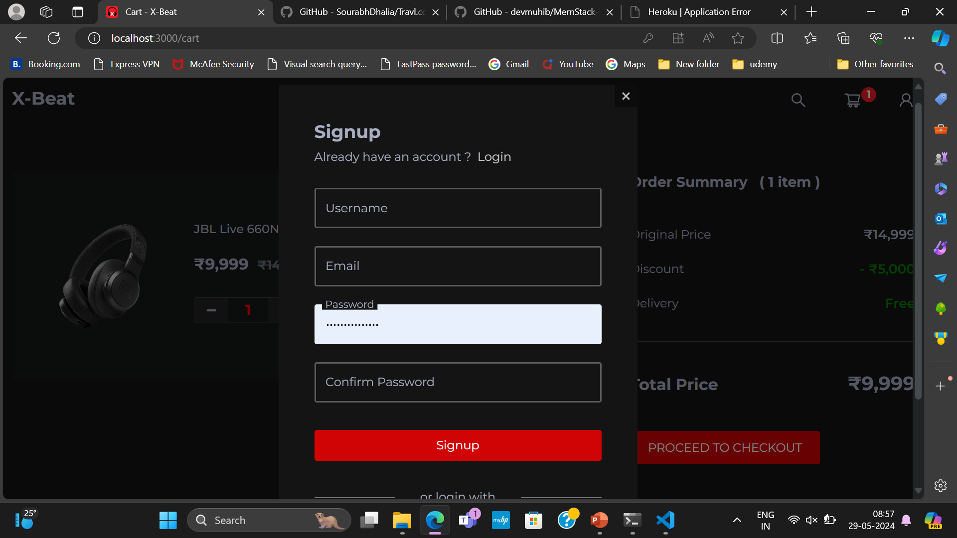
Registration Page

Slide 10
Product Adding Page
Product Listings: Display a variety of headset with images, descriptions, prices, and available quantities.
Filters and Search: Allow customers to filter plants by categories, such as indoor, outdoor, flowering, succulents, etc., and search for specific plants.
Product Details: Provide detailed information about each plant, including care instructions, size, and customer reviews.

Slide 11
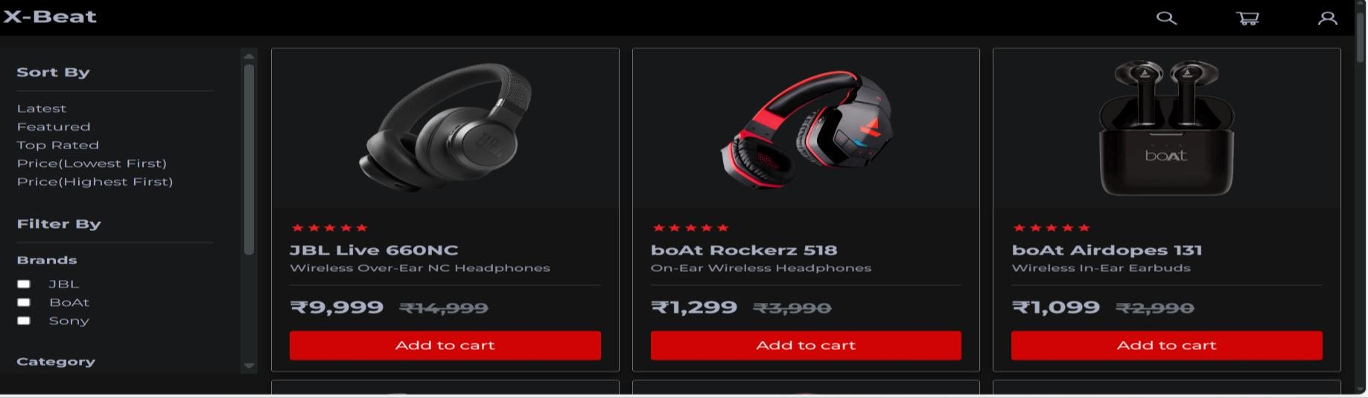
Product Adding Page

Slide 12
Cart Page
Cart PageCart Summary: Show a list of selected plants with quantities, prices, and subtotal.
Edit Cart: Allow customers to update quantities, remove items, or save items for later.
Estimated Total: Display the total cost, including any applicable taxes and shipping fees.

Slide 13
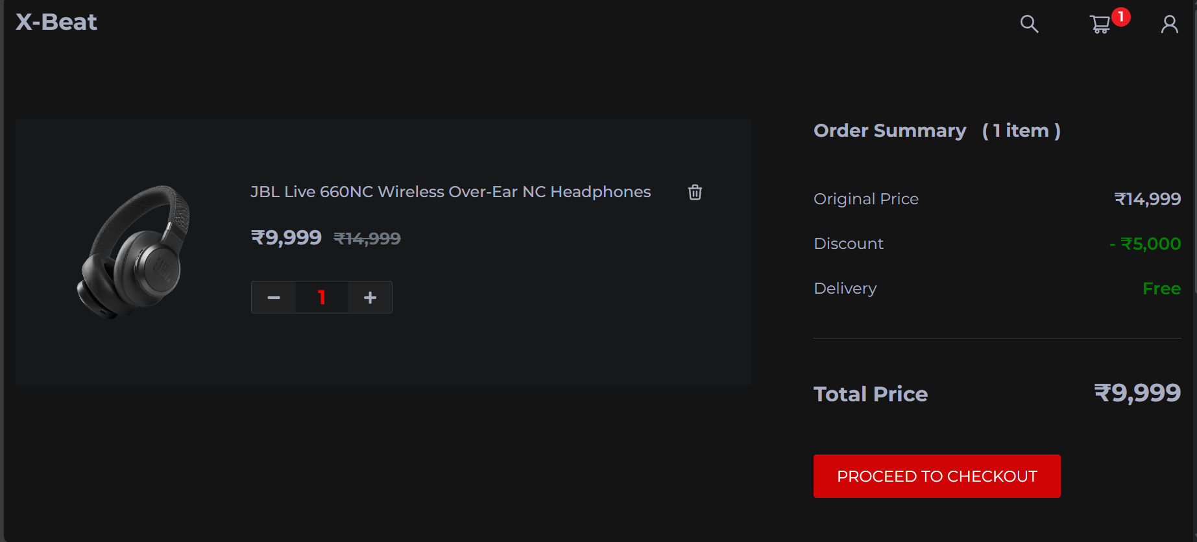
Cart Page

Slide 14
Payment Page
The payment module for the bicycle rental system will allow users to securely pay for their bicycle rentals using either PayPal or Stripe. This module will handle various payment-related tasks, including:
User authentication and authorization
Payment processing
Transaction management
Secure data transmission
Payment Gateway: Integrates with secure payment gateways to accept various payment methods, including credit/debit cards, digital wallets, and bank transfers.
Payment Status: Tracks the status of payments and provides users with receipts and payment confirmations.
View Bookings: After payment, allows users to view their upcoming and past bookings, including details and status.

Slide 15
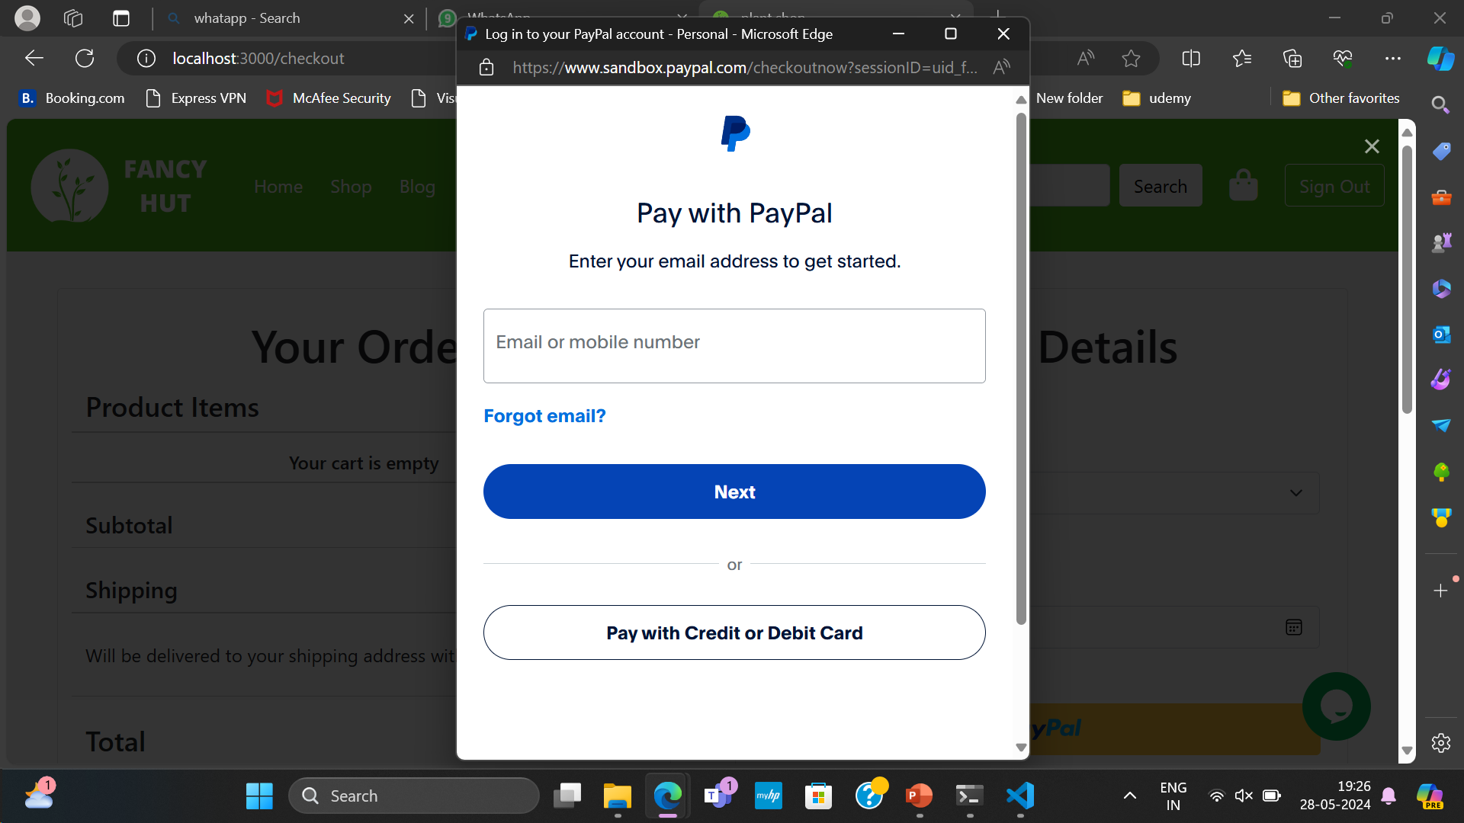
Payment Page

Slide 16
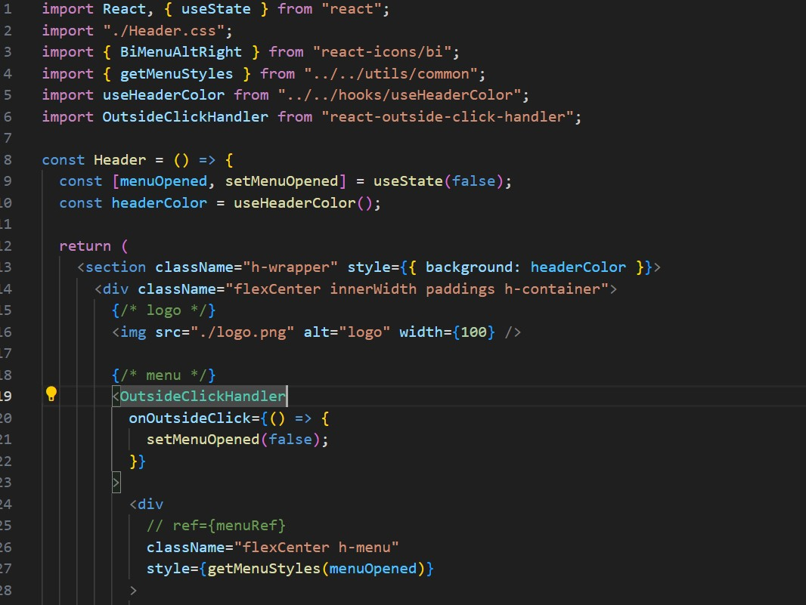
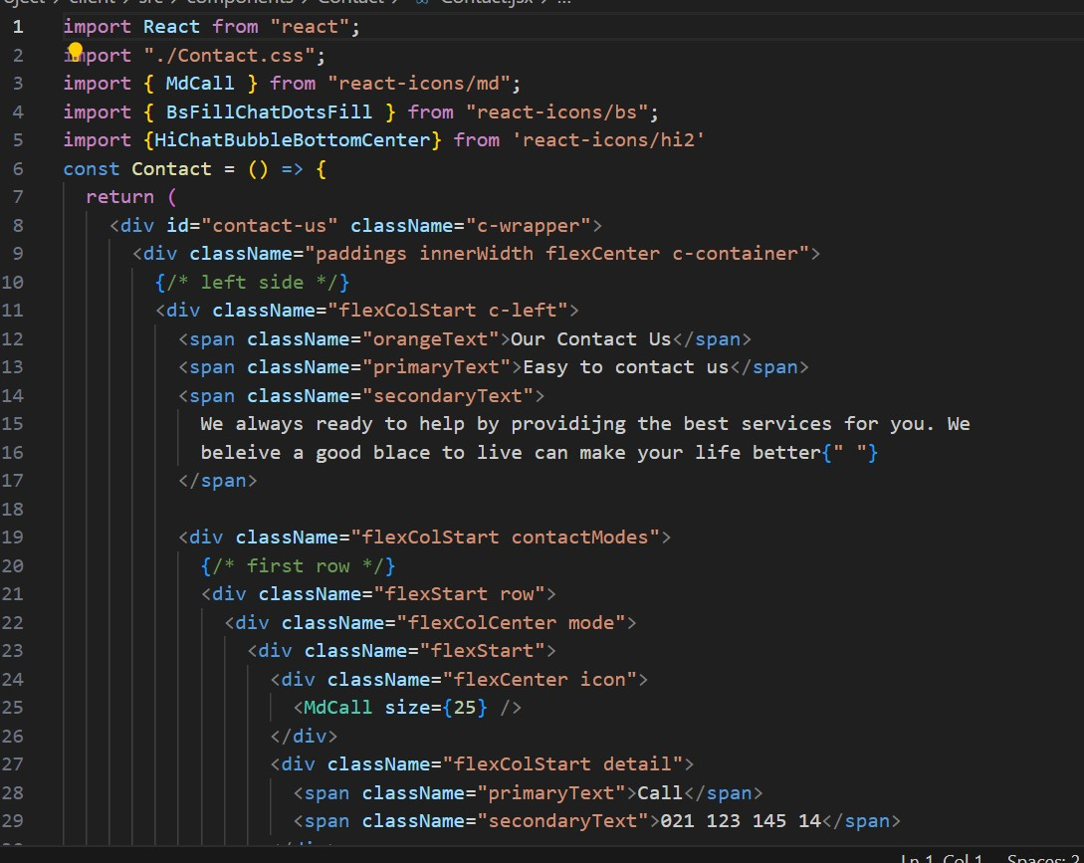
Frontend Code Screenshots

Slide 17
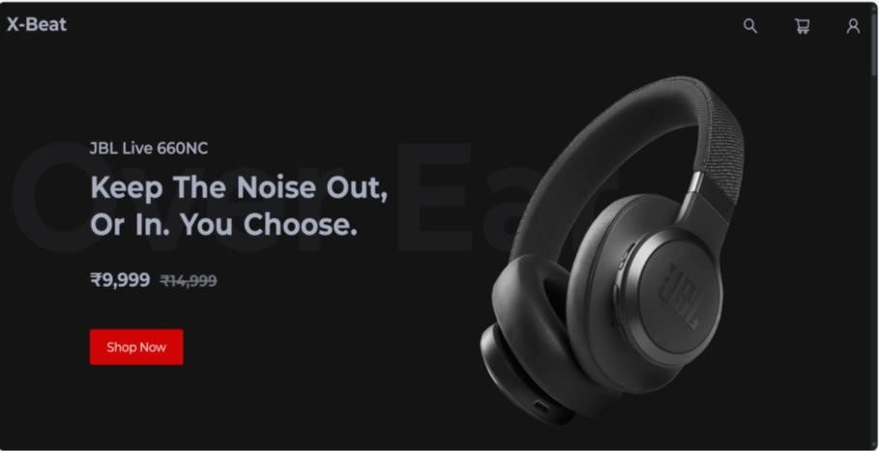
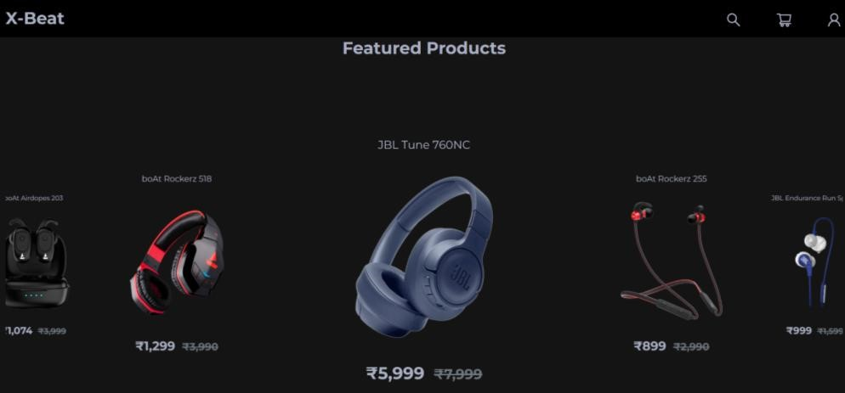
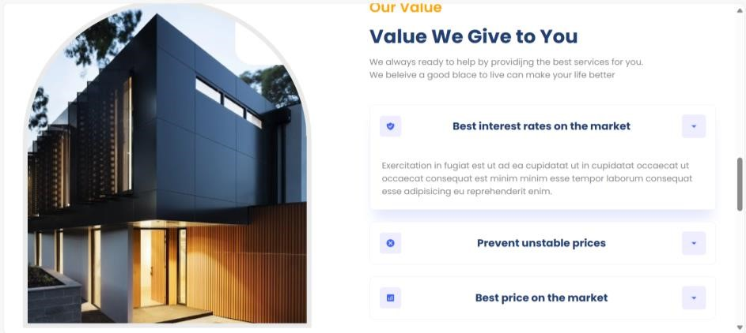

Frontend Output Screenshots

Slide 18
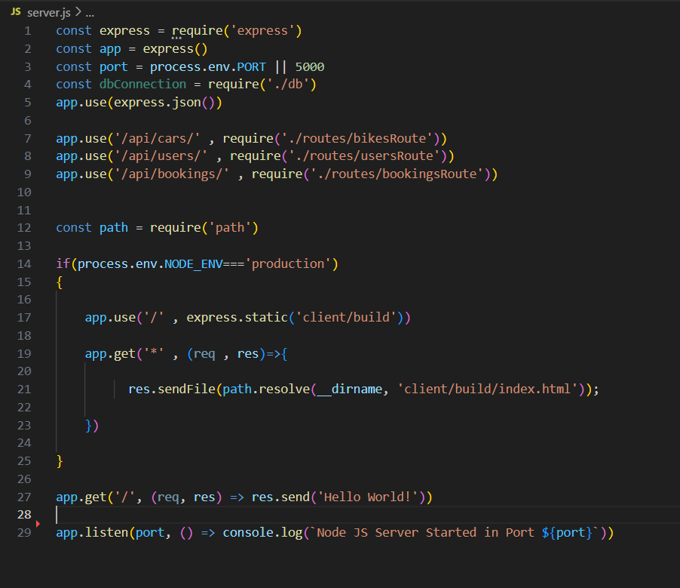
Backend Code Screenshot

Slide 19
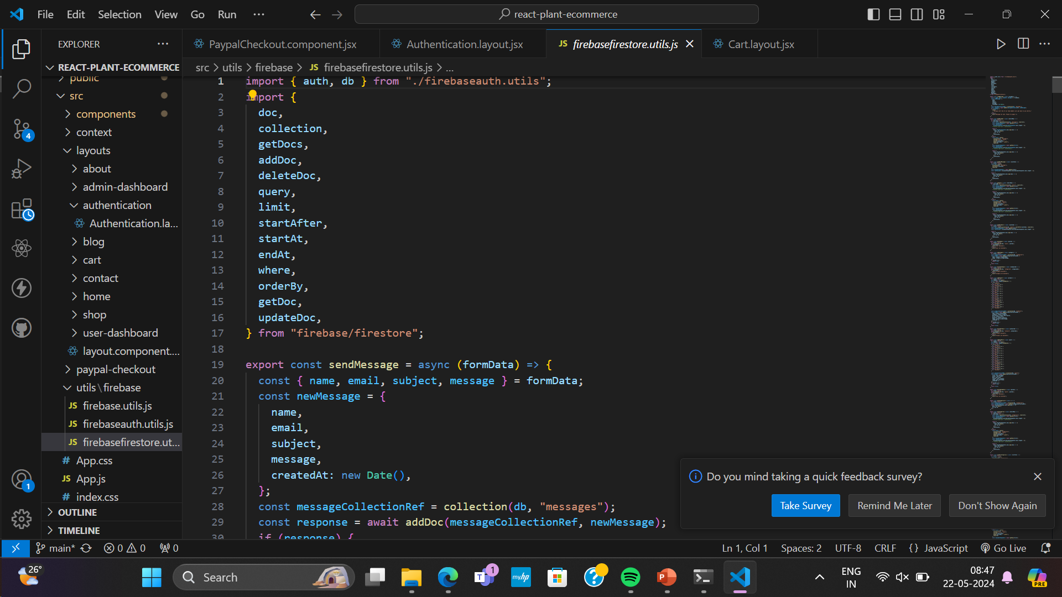
Database Connectivity Screenshot

Slide 20


